Slide 1
Introduction to Unit 3-4 Legal Studies

Slide 2
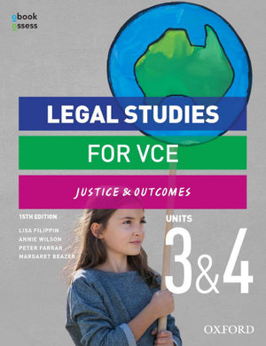

Slide 3
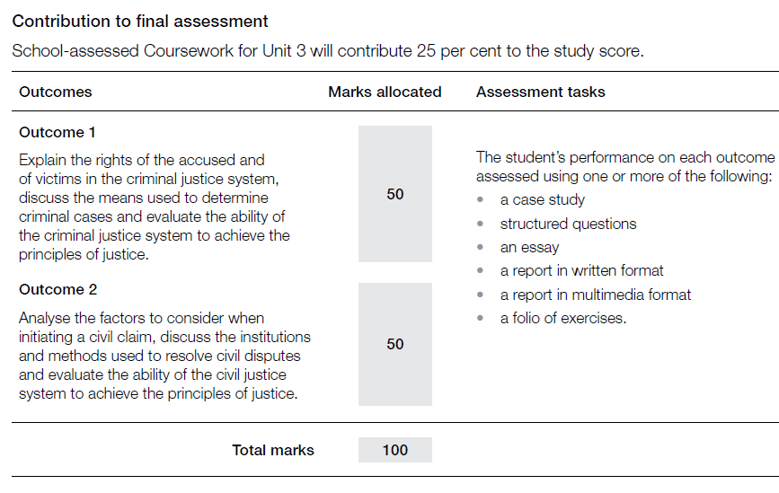
Unit 3

Slide 4
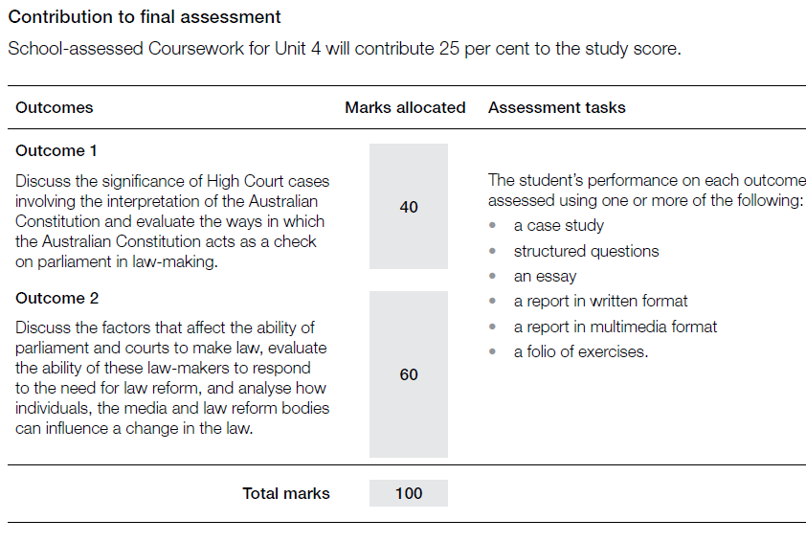
Unit 4

Slide 5

Keys to success
Use key documents
The Study Design
Past Exams and Exam Reports
Study
Keep up to date with your notes
Use whatever methods work well for you
Practice tasks
Follow the news
Look after yourself
Complete tasks to a high standard
Class handouts
Revise topics after class
Read questions carefully
Focus on task, limiting and content words
Read/listen/view reports on cases and legal issues
Choose your poison: Triple J Hack, 7 News, The Project, The Guardian, The Age, TikTok
Sleep
Eat and drink well
Exercise
Maintain balance
Control your social media use
Use your bookmarks
Be still
Notes:
Who needs a bookmark?

Slide 6

Compare the role of the jury in a criminal trial with the role of the jury in a civil trial. (4 marks)
Both a civil jury and criminal jury listen to the evidence presented by the parties as well as the directions from the judge about the law in order to decide a verdict.
In a civil jury there are 6 jurors and they decide the amount of damages awarded to a successful plaintiff. A civil jury is only used upon request. A criminal jury has 12 jurors and is used in trial if the accused pleads not guilty in the higher courts.
Notes:
How many marks is this response worth?
What is a strength of this response?
What is an improvement that could be made?

Slide 7
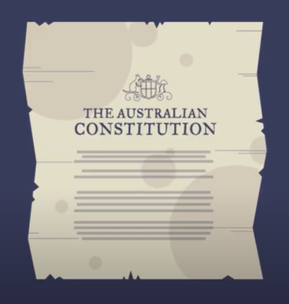
The Australian Constitution
A law enacted in 1901
6 British colonies became 6 states within a new nation: the Commonwealth of Australia
The Commonwealth Parliament was created to make laws for the nation
The High Court was created as the ‘guardian’ of the constitution
Notes:
https://www.youtube.com/watch?v=xyOH605fHW8

Slide 8
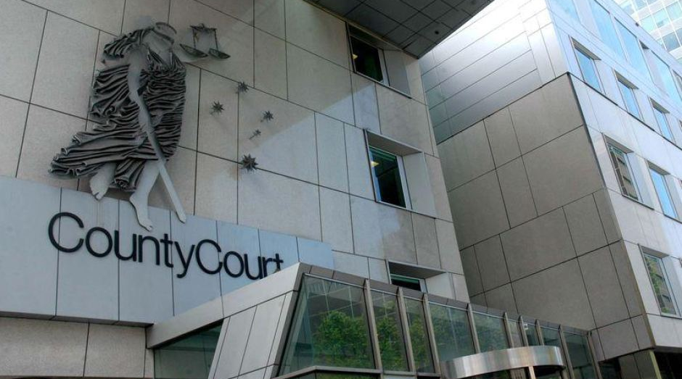
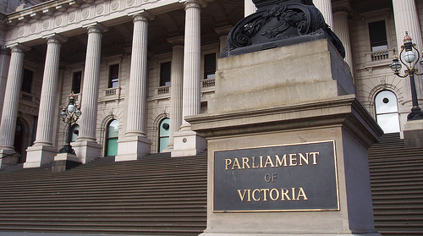
Sources of law
Courts make common law
Parliaments make statute law

Slide 9
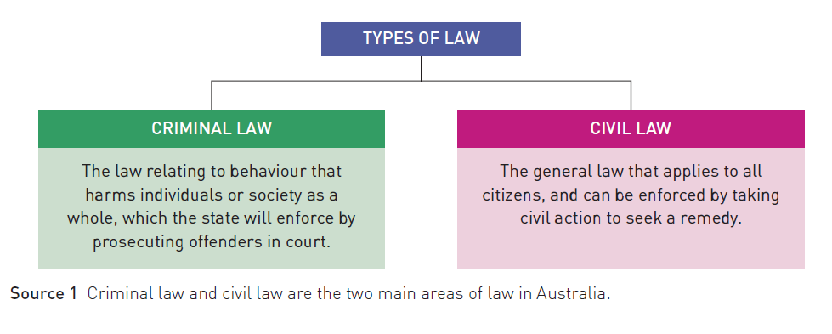

Slide 10
The rule of law
Everyone must comply with the law – it applies to all people
Laws should be such that people are willing and able to follow them
The parliaments must act in accordance with the constitution
Courts and judges must be independent from the government
The law must be applied equally, without discrimination
Trials are public and parties are able to present their case
People are free to criticise the government and to try to influence law-making

Slide 11
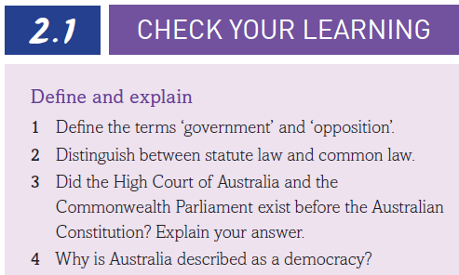
ANSWERS
Government has the most seats in the lower house and the opposition has the second-most seats.
Statute law is made by parliament whereas common law is made by courts.
ANSWERS
3. No. The Constitution created these institutions.
4. Because the people vote for representatives in parliament.

